Slide 1

Chapter 1 Time Value of Money
Interest: The Cost of Money
Economic Equivalence
Interest Formulas – Single Cash Flows
Equal-Payment Series
Dealing with Gradient Series
Composite Cash Flows.

Slide 2
Decision Dilemma—Take a Lump Sum or Annual Installments
A suburban Chicago couple won the Power-ball.
They had to choose between a single lump sum $104 million, or $198 million paid out over 25 years (or $7.92 million per year).
The winning couple opted for the lump sum.
Did they make the right choice? What basis do we make such an economic comparison?

Slide 3

 | Option A (Lump Sum) | Option B (Installment Plan)
0 1 2 3 25 | $104 M | $7.92 M $7.92 M $7.92 M $7.92 M

Slide 4

Introduction
What is time value of money?
Why it is Important in Economics Analysis?

Slide 5
Time Value of Money
Money has a time value because it can earn more money over time (earning power).
Money has a time value because its purchasing power changes over time (inflation).
Time value of money is measured in terms of interest rate.
Interest is the cost of money—a cost to the borrower and an earning to the lender

Slide 6
Interest
Rental value of money representing growth of capital per unit period.
Interest represents earning power of money.
It is the cost of using the capital.
For loss of earnings which would have been if money would had been invested for productive purposes
For the risk that the loan will not be paid
Administrative expense of making the loan
Compensation
factors

Slide 7
Simple Interest
In this case interest earned is directly proportional to capital involved in the loan.
If, I= interest earned through several time period.
P= Principal amount
i= rate of interest per period
N= number of interest periods (usually years)
Then, I= P * i *N
The total amount the borrower is supposed to pay the lender,
F= P + I => P + PiN => P(1+ iN)

Slide 8
Compound interest
This is the method of charging interest on the interest earned.
Total amount to pay, varies drastically when compared to simple interest charged.
Year end | Interest Rupees (@15%) | Compound Amount
0 |  | 100 | P
1 | 15 | 115 | P₁= P (1+i)
2 | 17.25 | 132.25 | P₂ = P₁ (1+i) = P (1+i)²
3 | 19.84 | 152.09 | P (1+i)³
F= P x (1 + i)^{n}
P- Principal Amount invested at time 0, F- Future amount,
i- interest rate compounded annually, n- period of deposits

Slide 9

Alternatively if we want100 Rs at the end of n_{th} year what should be the amount deposited now?
Similarly there are different interest formulas which are very useful for making investment decisions.

Slide 10
Time value equivalence
From economic point of view in time value conversion the equivalent values of money are determined not on values with equivalent purchasing power.
This can be easily understood with the following example.
If 1000 is kept in a locker for 2 years or as deposit in bank earning 10% annually.
Also, earning power could have been used to pay two equal annual installments of Rs.500 each.
(or initial deposit could have been reduced to 868 to pay out the installments.)

Slide 11
Types of interest factor
Compound amount factor
Annuity factor
FOR EQUAL PAYMENT SERIES SINKING FUND
Since the first payment occurs at the end of first period, F= A( 1 + i)^{N-1}
Similarly each payment treated in the same manner till the last payment N which receives no interest.
Therefore, F= A(1+i)^{N-1} + A(1+1)^{N-2} + ….+ A (1+i)^{N-N} ----------1
Factoring out A and multiplying through out by (1+i)
F(1+i) = A[ (1+i)^{N} + (1+i)^{N-1} + (1+i)^{N-2} +…+ (1+i)]------------------2
Subtracting, 2-1
F(1+i-1) = A[(1+i)^{N} – 1]
A = F [ i / (1+i)^{N} – 1]

Slide 12
Notations used in interest formulae
P – principal amount
n – number of interest periods
i – interest rate
F – future amount at the end of year n
A – equal amount deposited at the end of every interest period
G – uniform amount which will be added/subtracted period after period to/from the amount of deposit A1 at the end of period 1.

Slide 13
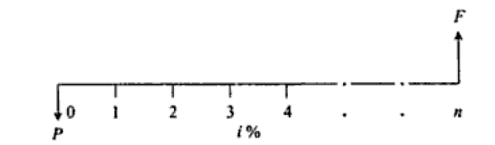
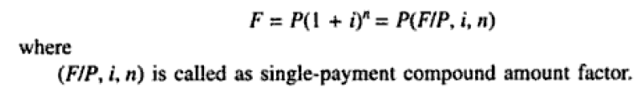
Types of Compound Interest Formulas
Single payment compound amount
Here the objective is to find the single future sum (F) of initial payment P after n period at interest rate i% compounded every period.

Slide 14
Example 1:
ANSWER: F= Rs. 1,04,680

Slide 15
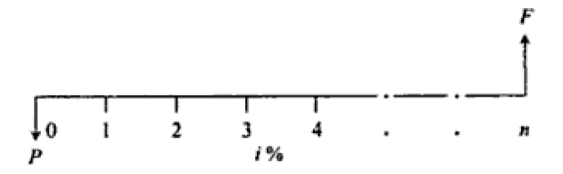
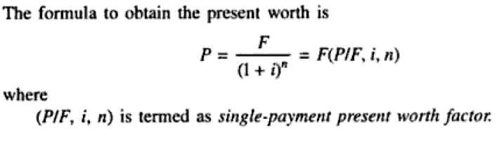
2. Single Payment Present Worth Amount
Here the objective is to find the present worth amount (P) of a single future sum (F) which will be received after n periods at an interest rate of i% compounded at the end of every interest period.

Slide 16
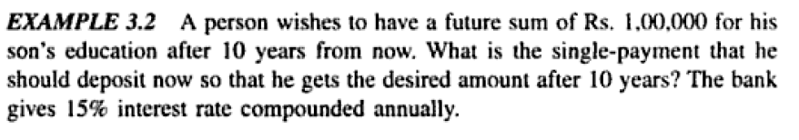
Example 2:
ANSWER: P= Rs. 24,720

Slide 17
numerical
Suppose you are offered the alternative of receiving either $3,000 at the end of five years or P dollars today. There is no question that the $3,000 will be paid in full (no risk). Because you have no current need for the money, you would deposit the P dollars in an account that pays 8% interest. What value of P would make you indifferent to your choice between P dollars today and the promise of $3,000 at the end of five years?

Slide 18
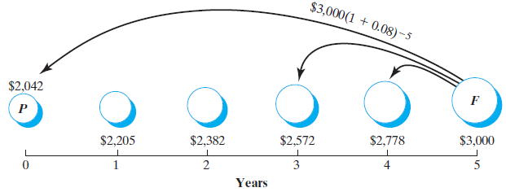
Equivalence
Figure 1: Various dollar amounts that will be economically equivalent to $3,000 in five years, given an interest rate of 8%

Slide 19
Numerical
A person is planning to invest Rs. 10,000 now and also an amount of Rs. 5000 in the 3rd year. He is expected to withdraw an amount of Rs 2000 for ever alternate years with first withdrawal starting from year 2. How much money will be left out in the account at the end of tenth year if the interest rate is 10%. (F balance= 20,502.5)

Slide 20
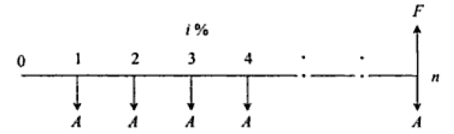
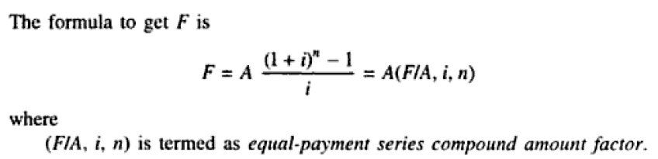
3. Equal Payment Series Compound Amount
Here the objective is to find the future worth of n equal payments which are made at the end of every interest period till the end of n_{th} interest period at an interest rate of i% compounded at the end of each interest period.

Slide 21

Example 3:
ANSWER: F= Rs. 47,19,810

Slide 22
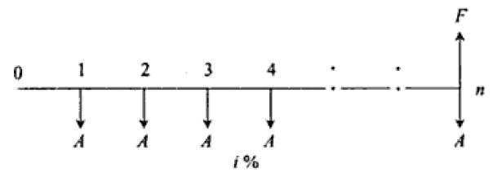
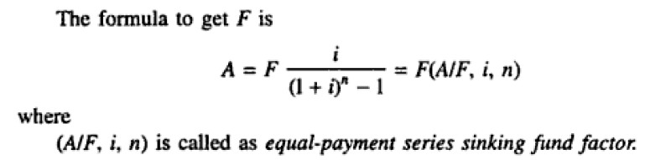
4. Equal Payment Series Sinking Fund
Here the objective is to find the equal amount (A) that should be deposited at the end of every interest period for n period to realize a future sum (F) at the end of n_{th} period at an interest rate of i%.

Slide 23
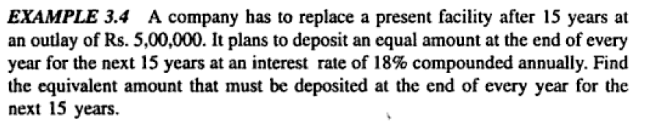
Example 4:
ANSWER: A= Rs. 8200 per year

Slide 24
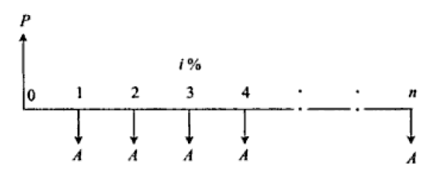
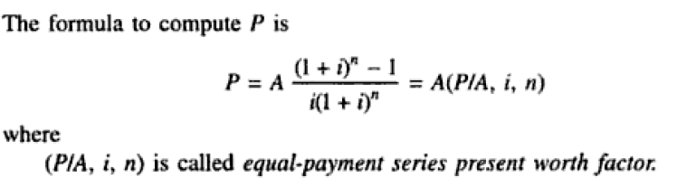
5. Equal Payment Series Present Worth
Objective is to find present the worth of an equal payment made at end of every interest period for n periods.

Slide 25
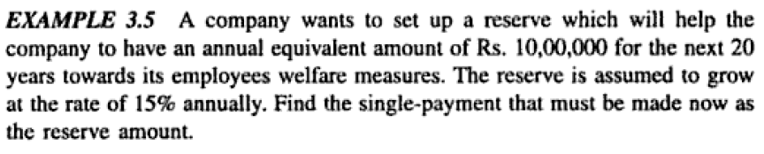
Example 5:
ANSWER: P= Rs. 62,59,300

Slide 26
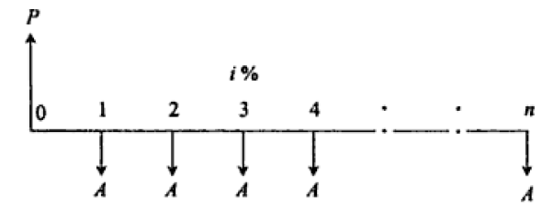
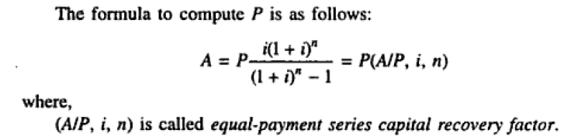
6. Equal Payment Series Capital Recovery Amount
Objective of this mode of investment is to find the annual equivalent amount (A) which is to be recovered at the end of every interest period for n interest periods for a loan (P) which is sanctioned now at an interest rate i% compounded every period.

Slide 27
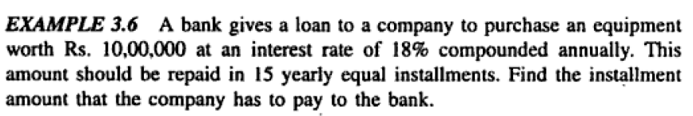
Example 6:
ANSWER: A= Rs. 1,96,400 Per Year

Slide 28
Examples

Slide 29
Numerical 1
How much money will be accumulated in 25 years if Rs. 800 is deposited at the end of 2nd year from now, Rs. 2400 six years from now and Rs. 3300 eight years from now all at an interest rate of 18% per year. (146739.2)
Also, find its equivalent annual worth (A) for this time period of 25 years.

Slide 30
Numerical 2
A person plans to have a retirement policy which will give him return when he reaches an age of 50. For this person whose age is 35 years now has to make annual premium payment of Rs. 19760 till he reaches an age of 49. if the interest rate is 8% compounded annually, what is the lumpsum he is getting an maturity for this policy
ANSWER: F= Rs. 5,16,765.77

Slide 31
Numerical 3
A boy is now 11 years old. On his fifth birthday he received a gift of $5,000 from his grandparents, which was invested in a 10 year fixed deposit bearing an interest rate of 6% per year compounded annually. His parents plan to have $6,000 available each year for the boy’s nineteenth to twenty second birthdays to help finance his college education. To assist the financing, the fixed deposit will be reinvested when it matures. If required how much equal amount should the parents deposit each year, beginning from his next birthday, so that one year after the last deposit they can start making payments to their son. All future investments will earn 6.5% per year compounded annually.

Slide 32
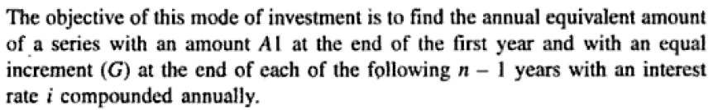
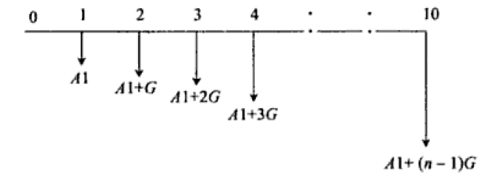
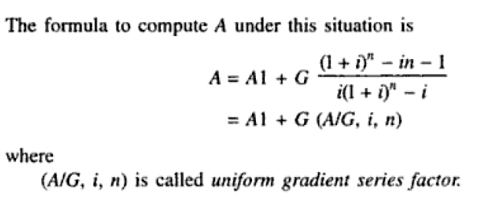
7. Uniform Gradient Series Annual Equivalent Amount

Slide 33
F= G (1 +i)^{n-2} + 2G (1+1)^{n-3} + 3g (1+i)^{n-4} +….+ (n-2) G (1+i) + (n-1)G-----1
Multiply B.S. of eq 1 by (1+i)
F(1+i) = G[(1 +i)^{n-1} + (1+1)^{n-2} + ….+ (n-2)(1+i)² + (n-1)(1+i)]--------2
Eq. 2 -1
Fi = G (1 +i)^{n-1} + G (1+1)^{n-2} +…………….. – (n-1)G
Fi = G[(1 +i)^{n-1} + (1+1)^{n-2} + ….+ (1+i)² + (1+i) +1] –nG
Fi= G (F/A,i,n) –nG
Multiply BS by (A/F,i,n)
Fi (A/F,i,n) = G (F/A,i,n) (A/F,i,n) – nG (A/F,i,n)
Ai = G – nG (A/F,i,n)

Slide 34
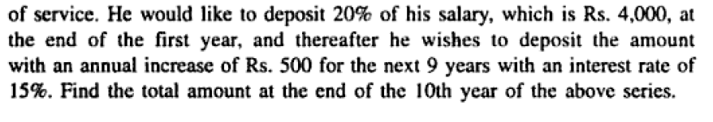
Example 7:
ANSWER: A= Rs. 5691.60 Per Year
F= Rs. 1,15,562.25

Slide 35
Example continued…

Slide 36
Numerical 1
A couple would like to determine what amount they must deposit in a savings account bearing 12% interest rate so that they will get Rs.5000/- at the end of 10th year and will get an increase of Rs.1000/- each year for the next 10 years. Draw the cash flow diagram.
Determine the present amount.
If the interest rate is compounded quarterly what is the present amount?

Slide 37
Numerical 2
Reconstruct the Cash flow diagram whose Future worth equation is as follows (n=15, i= 12%)
F=100(F/P,12%,14)+250(F/P,12%,12)+350(F/P,12%,10)+
450(F/P,12%,9)+750(F/P,12%,7)+1000(F/P,12%,5)+
1300(F/P,12%,4)+1600(F/P,12%,2)+1700
Notes:
1,3,5,6,8,10,11,13,15

Slide 38
Numerical 1
Suppose that you have a savings plan covering the next ten years, according to which you put aside $600 today, $800 at the end of every year for the next five years, and $2000 at the end of each year for the remaining five years. As part of this plan, you expect to withdraw $300 at the end of every year for the first 3 years, and $350 at the end of every year thereafter till the 10th year. In addition to this you are expected to withdraw an amount of $50 at the end of every 2 years till 15th year. Assume interest to be 12%.
Draw your cash flow diagram.
Find the amount accumulated in the saving account at the end of 15th year.
Answer- Amount in saving account is 30450

Slide 39
Nominal Interest rates
Interest rate are normally calculated on an annual basis.
However interest may be compounded several times in an year quarterly, half yearly or monthly etc. this is nominal interest rate.
Example- 1000 earning an interest rate of 8% compounded quarterly.

Slide 40
Effective interest rates
It is the ratio of interest charge for 1year to the principal,
This term actually eliminates the confusion over actual interest earned.
Consider the previous example of, 1year loan of Rs.1000 at a nominal interest rate of 8% compounded quarterly.
If compounded biannually at 8%, effective interest becomes?
Effective interest rate is (1 + r/m)^{n} – 1
Where r- nominal interest rate
m- number of compounding periods per year

Slide 41
Consider the following examples
Given information | Standard representation (Nominal rate, r) | Effective interest rate (on yearly)
0.5% per month
4.5% per semi-annual
2% per quarter
16% compounded quarterly

Slide 42
Example 1
Visteon, a spin-off company of Ford Motor Company, supplies major automobile components to auto manufacturers worldwide and is Ford's largest supplier. An engineer is on a Visteon committee to evaluate bids for new-generation coordinate-measuring machinery to be directly linked to the automated manufacturing of high-precision components. Three vendor bids include the interest rates. Visteon will make payments on a semi-annual basis only. The engineer is confused about the effective interest rates. What they are annually and over the payment period (PP) of 6-months.
Bid 1: 9% per year, compounded quarterly
Bid 2: 3% per quarter, compounded quarterly
Bid 3: 8.8% per year, compounded monthly
Determine the effective rate for each bid on the basis of semi-annual payments, and construct cash flow diagrams for each bid rate.
What are the effective annual rates? These are to be a part of the final bid selection.
Which bid has the lowest effective annual rate?

Slide 43
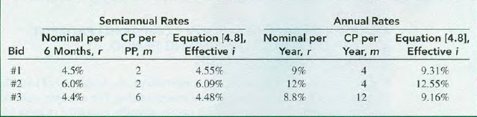
Answer

Slide 44
NUMERICAL 2
An amount of 1200 per year is to be paid into an account each for the next five years. Using a nominal interest rate of 12 % determine the total amount the account will have at the end of 5th year.
Deposit made at the end of each year with interest compounded monthly.
(ans. Effective interest = 12.68%; F= Rs. 7727)

Slide 45
Numerical 3
A company is planning to invest Rs. 6000 once in 6 months, the investment is made at the end of every 6th month, for next 5 years. The company is planning to utilize this amount accumulated at the end of 5th year for buying an asset. Identify the amount accumulated at the end of 5th year under following cases:
If interest is 12% compounded semi-annually. (Ans- 79084.7)
If interest is 12% compounded annually. (Ans- )
If interest is 12% compounded quarterly. (Ans- 79419.83)

Slide 46
NUMERICAL 5
An entrepreneur intending to start a new business knows that the first few years are the most difficult.
To lessen the chance of failure, a loan plan for start up capital is proposed in which interest paid during the first two years will be at 3% and at 6% for the next two years of the 6 years loan.
How large a loan can be justified for proposed repayments at the end of years 2,4,and 6 respectively Rs. 20,000 , Rs. 30,000 and Rs.50,000?

Slide 47
NUMERICAL 6
You will plan to retire 33 years from now, you expect that you will live 27 years after retiring. You want to have enough money upon reaching retirement age to withdraw 180,000 from the account at the beginning of each year. You expect to live , and yet still have 2,500,000 left in the account at the time of your expected death (60 years from now). You plan to accumulate the retirement fund by making equal annual deposits at the end of each year for the next 33 years. You expect that you will be able to ear 12% per year on your deposits. However, you only expect to ear 6% per year on your investment after you retire, since you will choose to place the money in less risky investments. What equal annual deposits you should make each year to achieve your retirement goal?

Slide 48
Numerical 7
A series of monthly cash flows is deposited into account that earns 12% nominal interest compounded monthly. Each monthly deposit is equal to $2100. The first monthly deposit occurred on June 1, 1998 and the last monthly deposit will be on January 1, 2005. The account (the series of monthly deposits, 12% nominal interest, and monthly compounding) also has equivalent quarterly withdrawals from it. The first quarterly withdrawal is equal to $5000 and occurred on October 1, 1998. The last $5000 withdrawal will occur on January 1, 2005. How much remains in the account after the last withdrawal?

